Slide 1
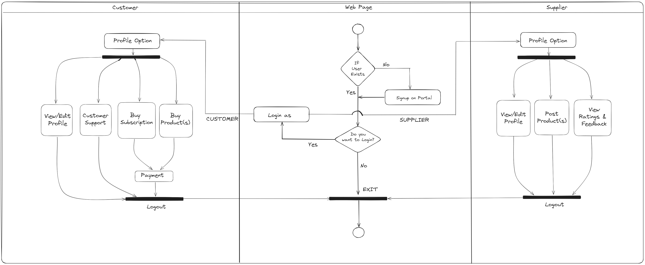
ACTIVITY DIAGRAM

